Slide 1

Introduction to
Communication System
CT-216
Convolution
Group- 28
Prof : Yash Vasavda
Mentor : Divyesh Ramani

Slide 2

Honor Code
The work we are presenting is our own.
We have not copied work from others.
Concepts and insights are our own.
We make this pledge truthfully.
Manya Shah - 202301424
Sheel Shah - 202301420
Manit Shah - 202301425
Pratik Chauhan – 202301435
Rajan Chauhan - 202301427
Jay Balar - 202301422
Naman Patel - 202301423
Het Patel - 202301421
Sujal Mohapatra - 202301428
Harshit – 202301431
Samay - 202301433

Slide 3
Content
What is communication ?
Introduction
Encoding
Modulation
AWGN
Demodulation
Decoding
Transfer Function

Slide 4
What is
Communication ?
Communication is the transfer of information from one point to another, typically involving a transmitter, a channel, and a receiver.
In communication systems, this process is achieved by converting data (voice, text, video) into electrical or electromagnetic signals.
Real-life applications include mobile phones, satellite links, Wi-Fi, television broadcast, and even deep-space missions.
To ensure data integrity over noisy channels, modern communication systems use error-correcting codes like convolutional codes.
These codes help detect and correct errors introduced during transmission, making communication reliable and efficient, especially in environments like GSM, Wi-Fi, and space telemetry.

Slide 5
Content
What is communication ?
Introduction
Encoding
Modulation
AWGN
Demodulation
Decoding
Transfer Function

Slide 6
Introduction to Convolution Code
A convolutional encoder processes the information sequence continuously.
The n-bit encoder output at a particular time depends not only on the k-bit information sequence, but also on m previous input blocks using shift registers.
A convolutional encoder has a memory order of m.
The set of sequences produced by a k-input, n-output encoder of memory order m is called an (n, k, m) convolutional code.
The values of n and k are much smaller for convolutional codes compared to block codes.

Slide 7
Why Convolution Code?
Convolutional coding enhances communication reliability by correcting errors in noisy channels.
Unlike block codes, convolutional codes encode and decode data as a continuous stream.
Convolutional codes offer lower latency than polar and LDPC codes, ideal for real-time systems.
Convolutional encoders are simple to implement in hardware using shift registers and logic gates
It introduces memory into the encoding process by using past input bits, which improves error correction capability
Their efficiency and simplicity make convolutional codes a preferred choice for many applications.

Slide 8

Why is it Convolution Coding?

Slide 9
Before Explaining the encoding algorithm,
Notation :
k : No. of inputs bits which can be passed to the encoder at once .
N : No. of output bits for every k input bits.
3. Kc : Constraint length ( total Kc no. of bits which are encoded at once)
g : Generator matric ( which generates output bits by modulo 2 dot product with the current constraint bits.
5 r = k/N

Slide 10
Block Diagram
Convolution
Encoder
Rate: k/n
Length: K
Example: (1,2,3)
Generator:
G1- 111
G2- 101
Modulator
(eg. BPSK , QPSK )
Bits-to-symbol
Mapping
Input message
m (Bitstream)
Bitstream m
Codeword c
Symbol s
Noisy
Channel
(AWGN)
Viterbi Decoder
Trellis-Bases
Decoding
ML Estimation
Output Message m
Estimated m
Decoded Bits
Demodulator
Soft/Hard Decision
Received r = s+n

Slide 11
Content
What is communication ?
Introduction
Encoding
Modulation
AWGN
Demodulation
Decoding
Transfer Function

Slide 12
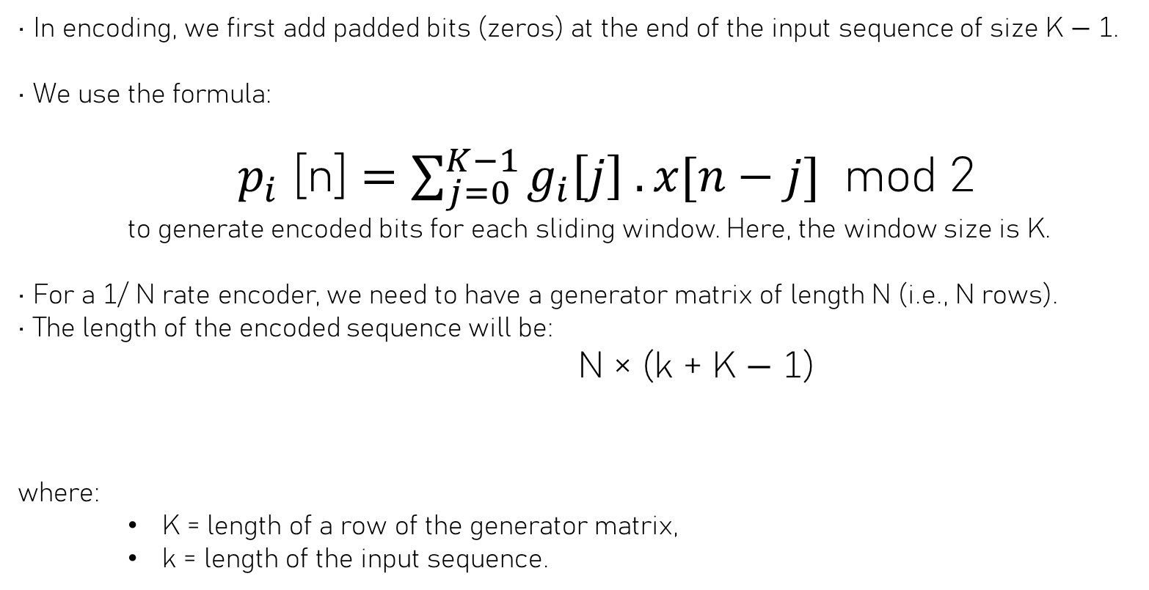
Encoding
• In encoding, we first add padded bits (zeros) at the end of the input sequence of size K − 1.
• We use the formula:
$p_{i}$ [n] $=\sum_{j=0}^{K−1}{g_{i}\left[j\right] .x[n−j]}$ mod 2
to generate encoded bits for each sliding window. Here, the window size is K.
• For a 1/ N rate encoder, we need to have a generator matrix of length N (i.e., N rows).
• The length of the encoded sequence will be:
N × (k + K − 1)
where:
K = length of a row of the generator matrix,
k = length of the input sequence.

Slide 13
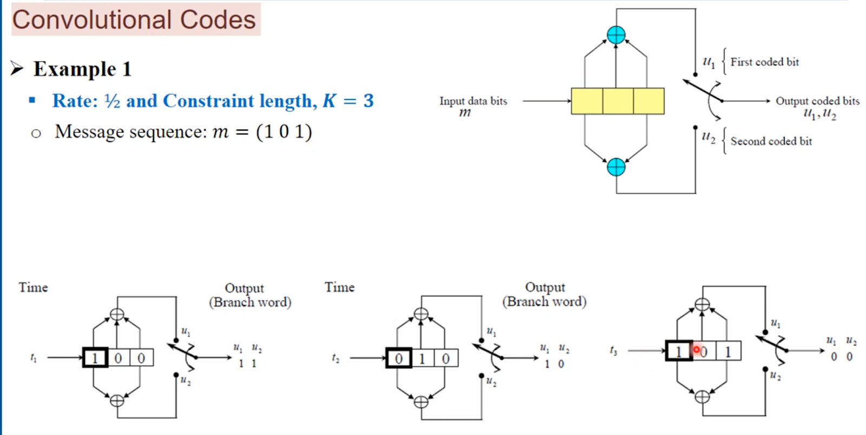
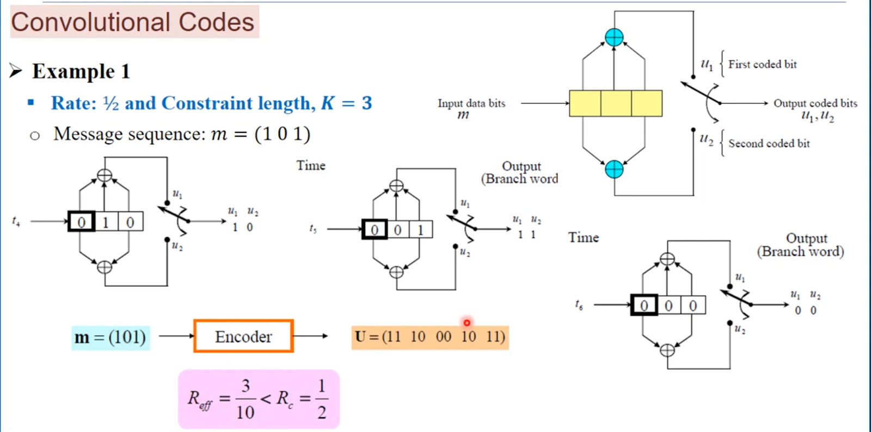
In this one bit after another will be taken as input and for each input taken xor operations are performed to get encoded bits.
Here, after the 3 bits are given as input we are padding with zeroes to flush out the non-zeroes bits.

Slide 14
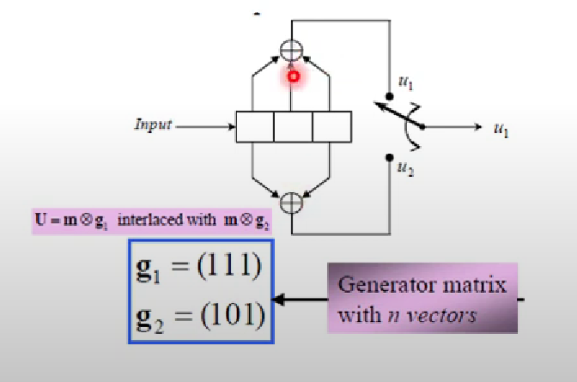
The i-th element in each vector is "1" if i-th stage in shift register is connected to the corresponding mod-2 adder, and "0" otherwise

Slide 15
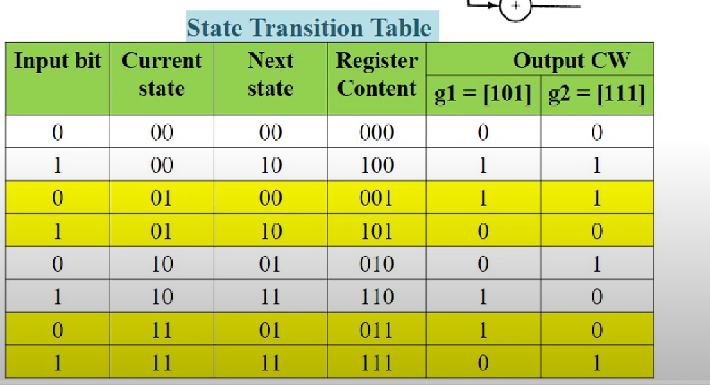



STATE TRANSITION TABLE

Slide 16
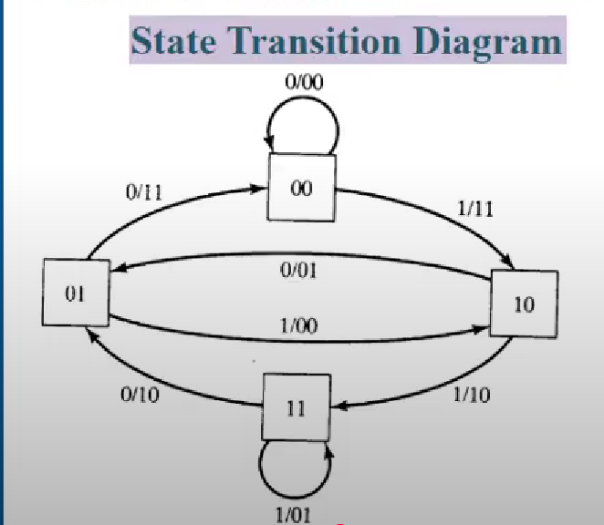
STATE TRANSITION DIAGRAM
In adjacent figure, the state diagram is shown.​
​
​
From this we can see how the state changes when input is 0 or 1 along with the corresponding outputs as well.​

Slide 17
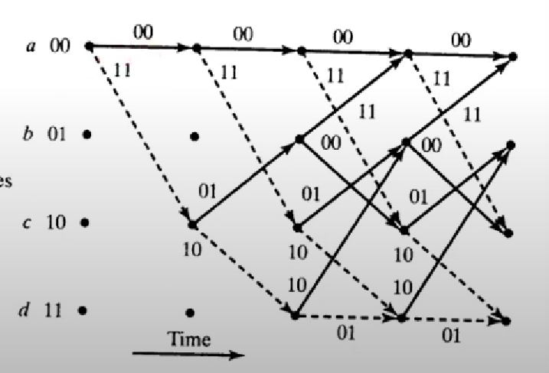
Trellis Diagram

Slide 18
Content
What is communication ?
Introduction
Encoding
Modulation
AWGN
Demodulation
Decoding
Transfer Function

Slide 19
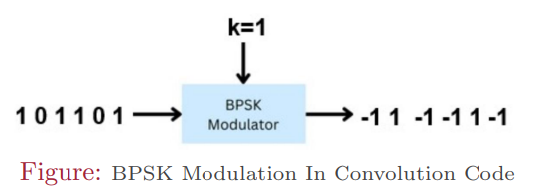
Modulation
We use BPSK Modulation in the encoded codeword. BPSK (Binary Phase Shift Keying) is a digital modulation scheme used in communication systems to transmit binary data (0s and 1s) over a communication channel.
• Bit 0 is modulated to the symbol 1.
• Bit 1 is modulated to the symbol -1.
Modulation formula Used:
s = 1 − 2b where b ∈ {0, 1}

Slide 20
Content
What is communication ?
Introduction
Encoding
Modulation
AWGN
Demodulation
Decoding
Transfer Function

Slide 21
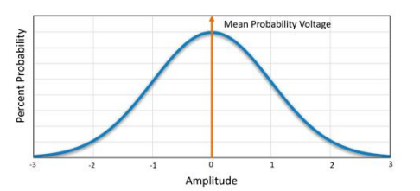
AWGN
Additive White Gaussian Noise (AWGN) is characterized by being additive, having a constant power spectral density across frequencies (white), and following a Gaussian probability distribution.
The AWGN is typically modeled as a random variable with:
• Zero mean: µ = 0
• Variance: σ^2
It is denoted as:
n ∼ N (0, σ^2 )

Slide 22
Content
What is communication ?
Introduction
Encoding
Modulation
AWGN
Demodulation
Decoding
Transfer Function

Slide 23
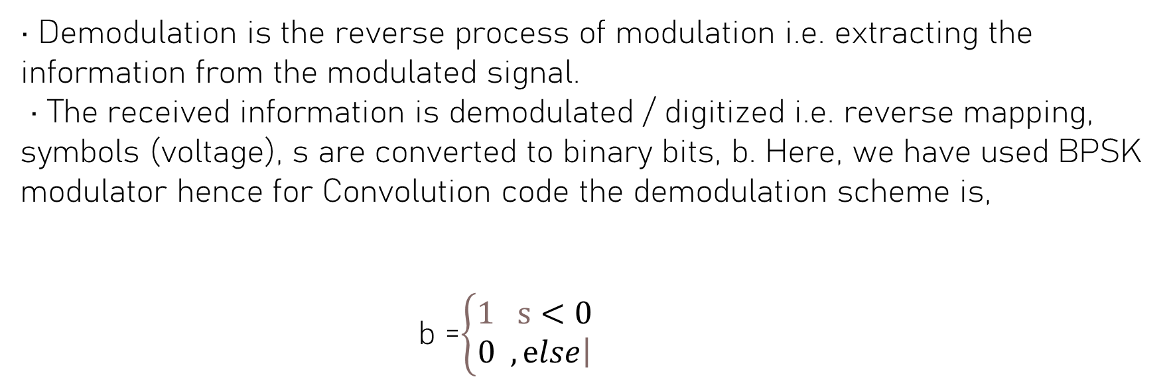
Demodulation
• Demodulation is the reverse process of modulation i.e. extracting the information from the modulated signal.
• The received information is demodulated / digitized i.e. reverse mapping, symbols (voltage), s are converted to binary bits, b. Here, we have used BPSK modulator hence for Convolution code the demodulation scheme is,
b =$\left\{\begin{matrix}1 s<0 \\ 0 ,\left.ⅇlse\right|\end{matrix}\right.$

Slide 24
Content
What is communication ?
Introduction
Encoding
Modulation
AWGN
Demodulation
Decoding
Transfer Function

Slide 25
Decoding
For Decoding, there are various algorithms to decode like Viterbi,BCJR. But for our project we will consider the Viterbi Algorithm.
• In the Viterbi algorithm, we use a trellis data structure. There are two types of Viterbi decoding techniques: HDD (Hard Decision Decoding) and SDD (Soft Decision Decoding).
• In the case of HDD, we use Hamming Distance.
• In the case of SDD, we use Euclidean Distance.
• Let’s see the process of decoding using the Viterbi algorithm.
For example, let’s consider the following:
• Original message: [1 0 1 1 0 0 ]
• Received message: [11 10 11 00 01 11]

Slide 26
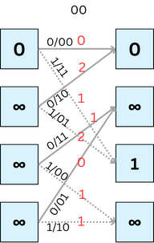
Hard Decision Decoding
For decoding purposes in convolution codes, the trellis provides a convenient way to understand the time evolution of the state machine.
Let us define two metrics which we discussed about in previous slide for hard decision decoding.
Branch Metric (BM): BM is the measure of the hamming distance between the received codeword and the expected parity bits (Hamming distance: No of places where corresponding bits are different)
Path Metric (PM): PM is the sum of the branch metric of the branches it traversed in the path.
PM[s, i + 1] = min(PM[α, i] + BM[α → s],PM[β, i] + BM[β → s])
(Where α , β are the states at time i and s is the state reachable from α and β at time i+1)
Time: i i+1
0 0
0 1
1 0
1 1
State

Slide 27
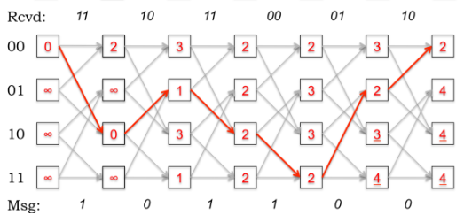
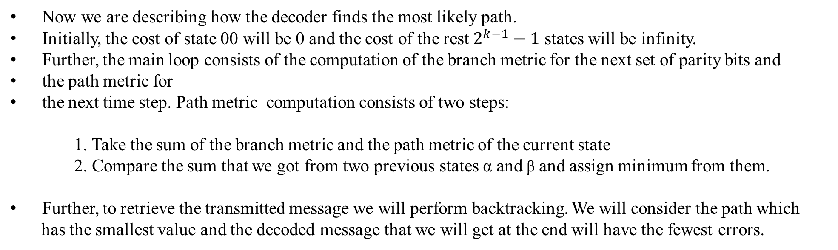
Hard Decision Decoding
Now we are describing how the decoder finds the most likely path.
Initially, the cost of state 00 will be 0 and the cost of the rest $2^{k−1}−1$ states will be infinity.
Further, the main loop consists of the computation of the branch metric for the next set of parity bits and
the path metric for
the next time step. Path metric computation consists of two steps:
1. Take the sum of the branch metric and the path metric of the current state
2. Compare the sum that we got from two previous states α and β and assign minimum from them.
Further, to retrieve the transmitted message we will perform backtracking. We will consider the path which
has the smallest value and the decoded message that we will get at the end will have the fewest errors.
These bits represent the input(for the highlighted branches)
which we give to the current state to reach the next state. This is the decoded message.

Slide 28
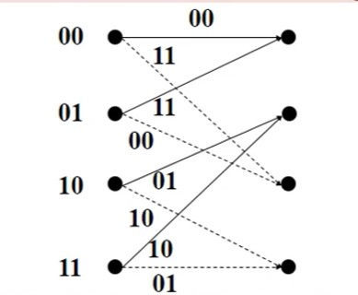
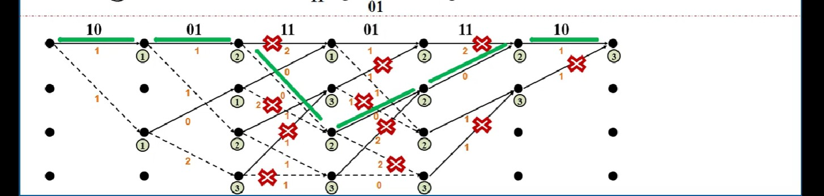
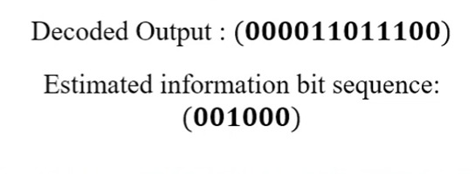
Hard Decision Decoding Example
Suppose the received code-word after demodulation is obtained as:
Received message: [10 01 11 01 11 10]
And Trellis Diagram for state transition is :
s

Slide 29
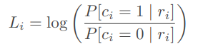
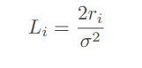
Soft Decision Decoding
In principle, the soft decision decoding works on the Bayesian Theorem, whereas the hard decision decoding is an ad-hoc method that is preferred because it may be computationally simpler to implement.
In general, soft decision decoding improves the performance
Instead of using hard decisions on the bits, soft decisions can be used. This requires that the input to the decoder be a Log-Likelihood Ratio (LLR) in the form:
For BPSK modulation in AWGN, the LLR becomes:

Slide 30
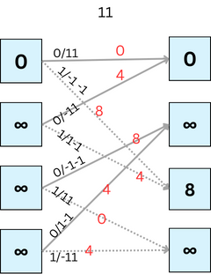
Soft Decision Decoding
In Soft decision decoding we do not demodulate received signal instead we take Euclidean distance with 1/-1.
For soft decision decoding in convolution codes the computation of the path matric and the Viterbi decoding algorithm will remain the same as hard decision decoding.
The only difference in soft and hard decision decoding is the computation of the branch metric.
Let us define the branch metric for soft decision decoding.
Branch Metric (BM): The branch metric for soft decision decoding is the Euclidean distance between the
received message and the expected message.
Time: i i+1
0 0
0 1
1 0
1 1
State
Let’s see visualization of computing trellis and backtracking for soft decision decoding.

Slide 31
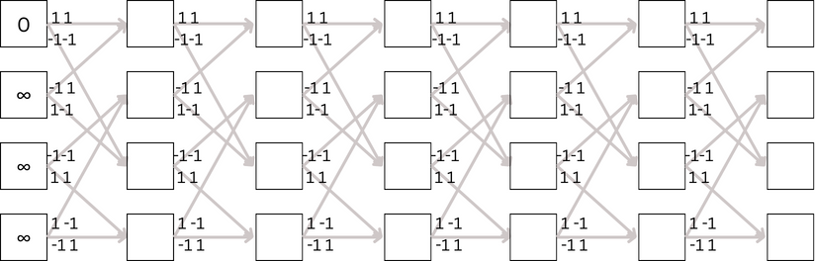
Soft Decision Decoding
Rcvd:
-1 -1
-1 1
-1 -1
1 1
1 -1
-1 1
00
0 1
1 0
1 1

Slide 32
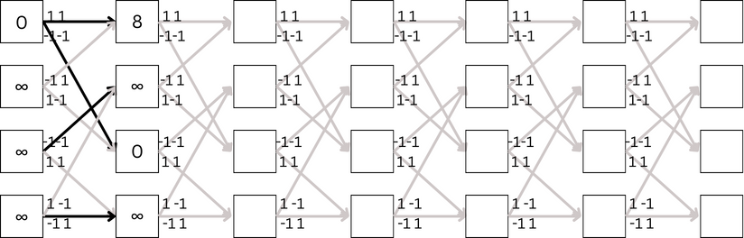
Soft Decision Decoding
Rcvd:
-1 -1
-1 1
-1 -1
1 1
1 -1
-1 1
00
0 1
1 0
1 1

Slide 33
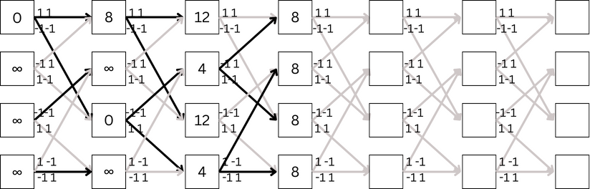
Soft Decision Decoding
Rcvd:
-1 -1
-1 1
-1 -1
1 1
1 -1
-1 1
00
0 1
1 0
1 1

Slide 34
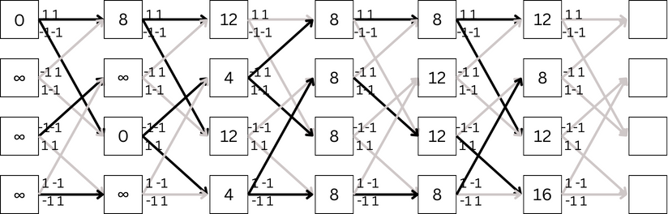
Soft Decision Decoding
Rcvd:
-1 -1
-1 1
-1 -1
1 1
1 -1
-1 1
00
0 1
1 0
1 1

Slide 35
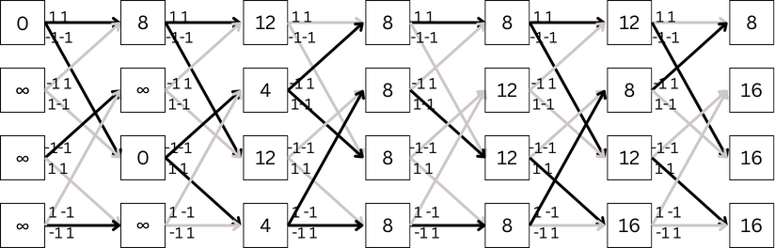
Soft Decision Decoding
Rcvd:
-1 -1
-1 1
-1 -1
1 1
1 -1
-1 1
00
0 1
1 0
1 1

Slide 36
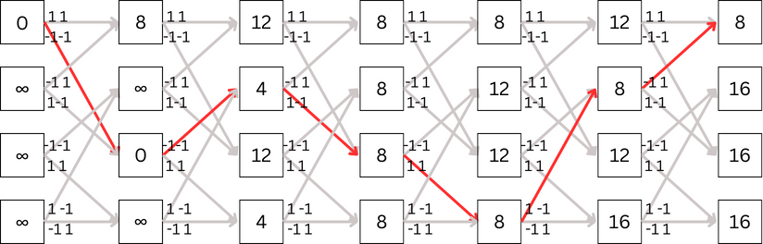
Soft Decision Decoding
Rcvd:
-1 -1
-1 1
-1 -1
1 1
1 -1
-1 1
00
0 1
1 0
1 1
Msg:
1
0
1
1
0
0

Slide 37
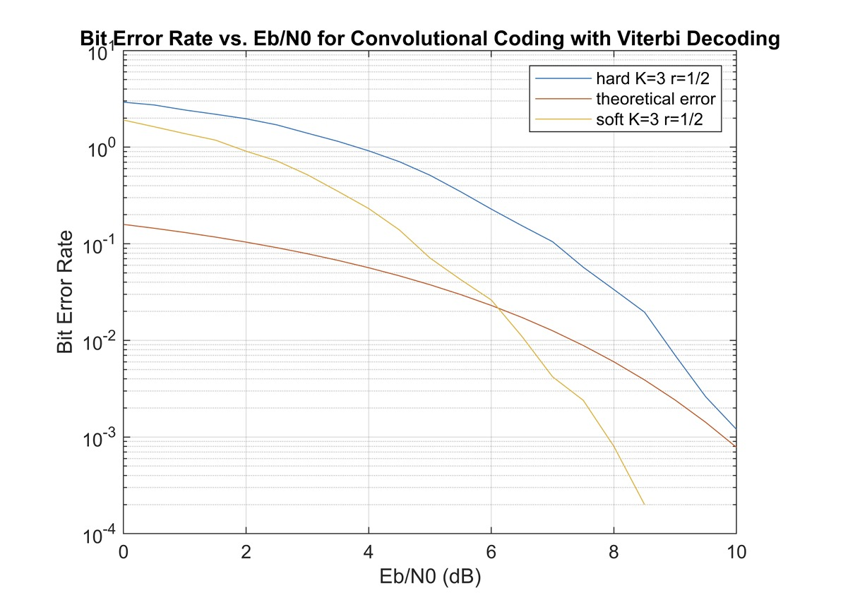
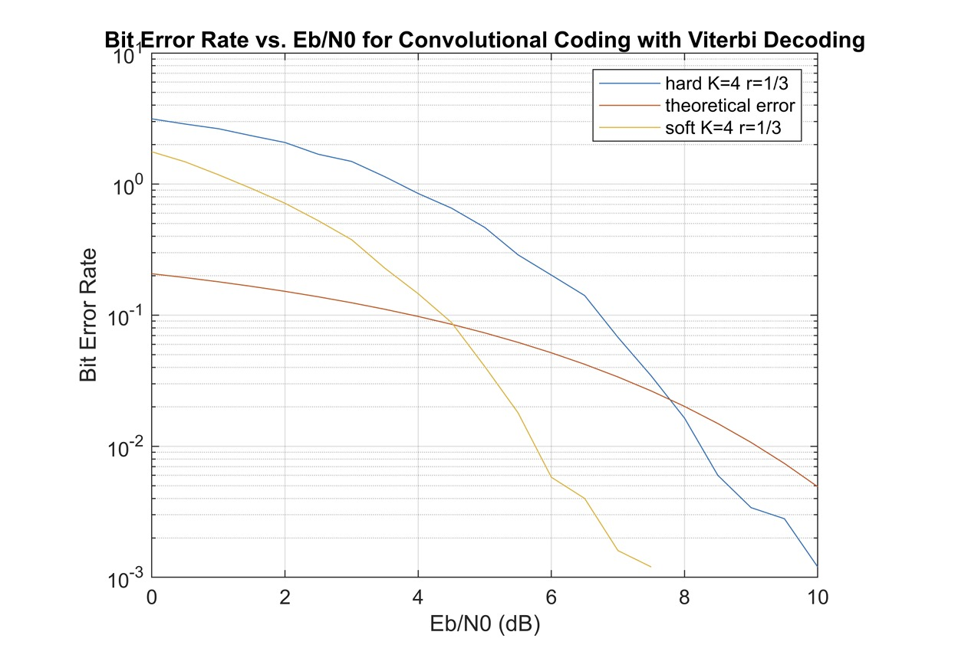
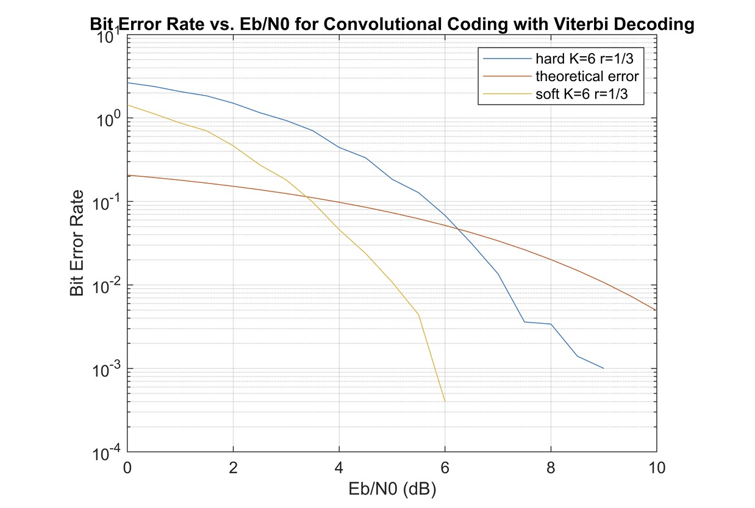
Simulation results
The plots depict the performance of the Viterbi hard and soft decoders for different rates and constraint lengths.

Slide 38
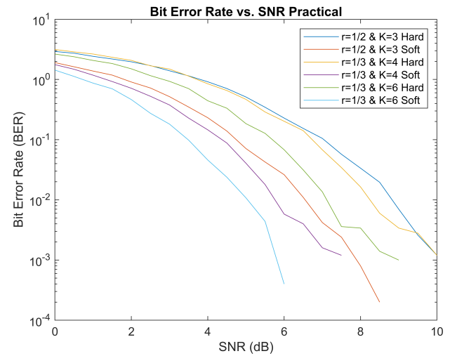
Observations from Plots
Performance of both Viterbi hard and soft for each case increases with the increase in SNR.
The BER is higher for lower SNR which suggests that Viterbi hard performs better for minimal noise.
The same goes for Viterbi-soft decision decoding but it performs better than Viterbi-hard.
Lower code rates enhance the performance of the decoders but it also introduces overhead.
Larger constraint length enhances error correction significantly but the cost is significant increase in time due to increase in computation complexity.
The overall performance of soft decision decoding is much better than the hard decision. The reasons can be:
In hard decision decoding, each of the received symbol is demodulated to bits considering a specific threshold. This leads to ambiguity because decoder may choose incorrect bits due to uncertainty.
Soft decision decoder using the received symbols rather than demodulating them to bits. Unlike Viterbi hard, there is no room for ambiguity here.

Slide 39
Content
What is communication ?
Introduction
Encoding
Modulation
AWGN
Demodulation
Decoding
Transfer Function

Slide 40
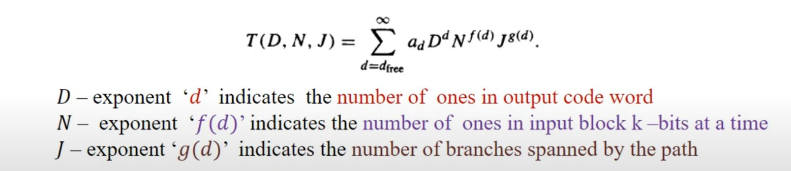
Transfer Function
It is algebraic representation of all paths that start and end at all zeroes.

Slide 41
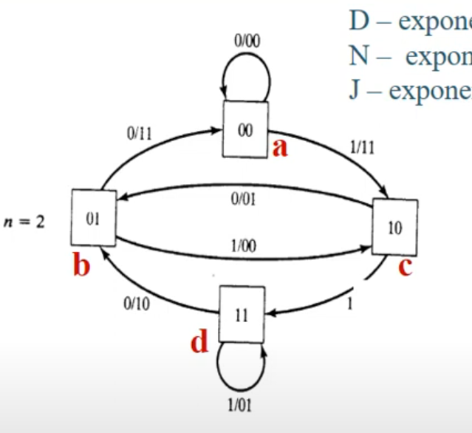
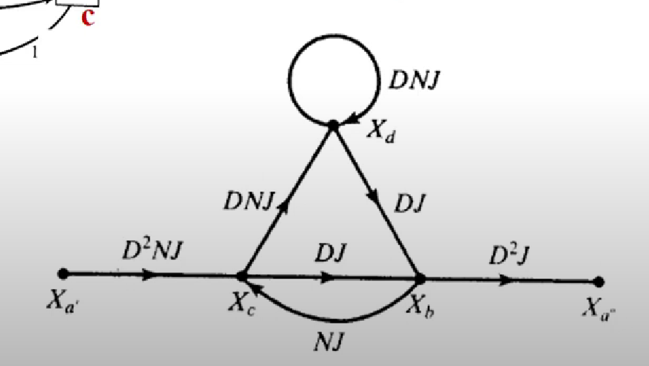
Transfer Function

Slide 42
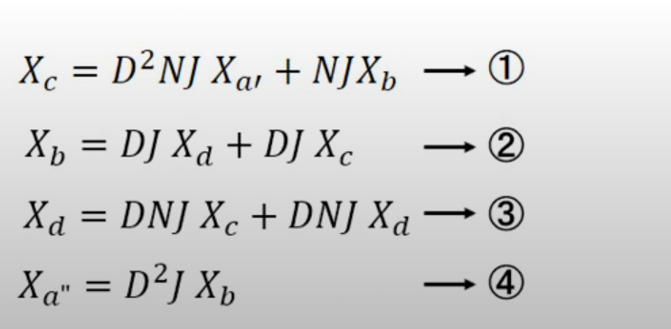
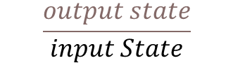
Transfer Function
Transfer function =
$$\frac{output state}{input State}$$

Slide 43
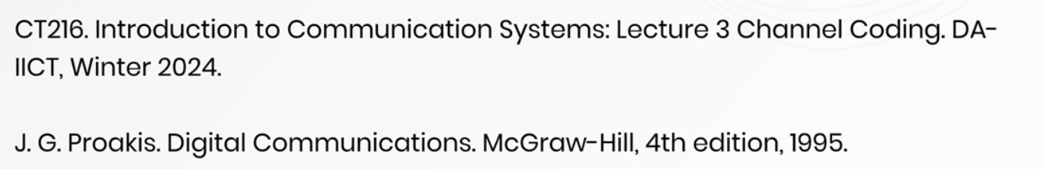
Reference
https://youtube.com/playlist?list=PLEvcKrs3Cncr62hoBymwX5lnLFlwGe9SX&si=8Zb0P6zWFkSUfc7B

